Slide 1
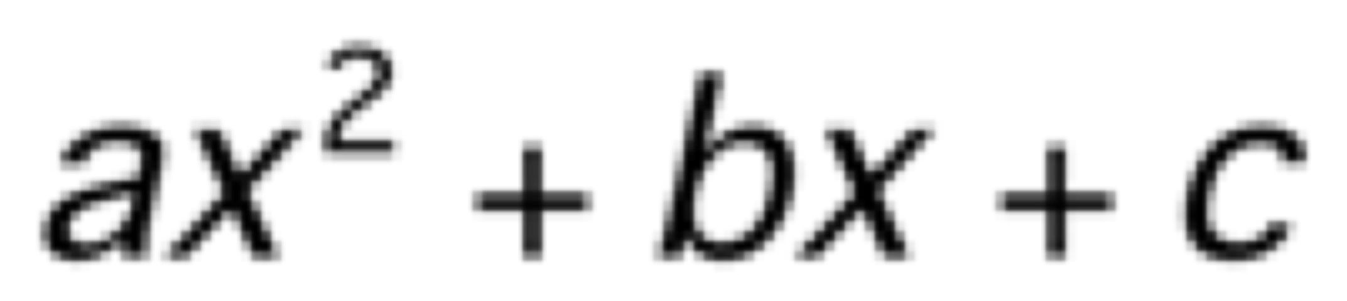
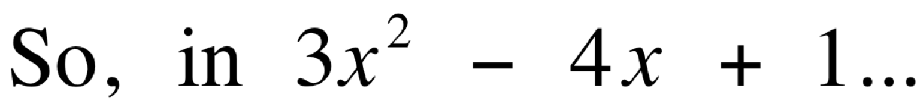

Standard Form
The standard form of any quadratic trinomial is
a=3
b=-4
c=1

Slide 2
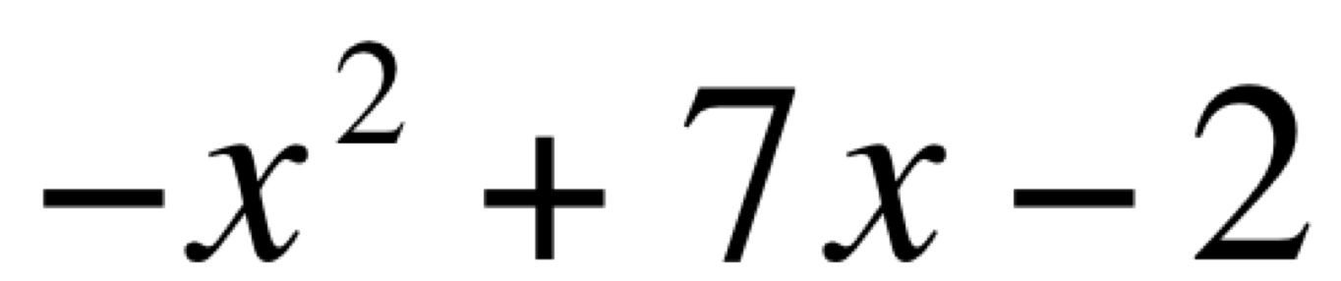
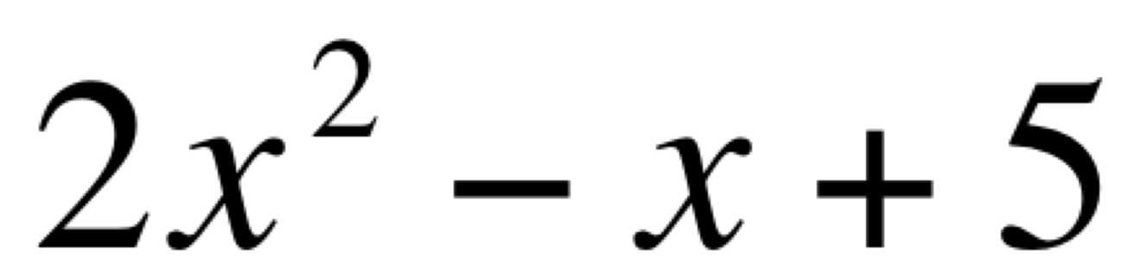
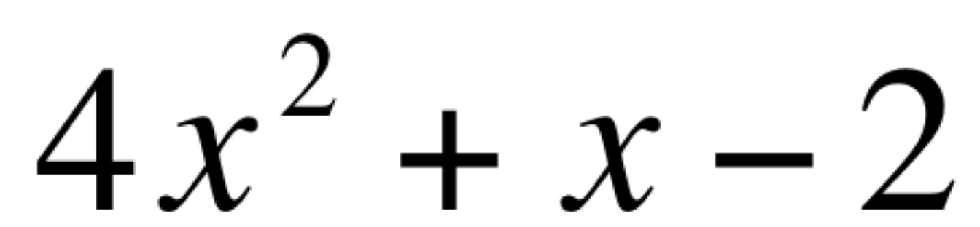
Now you try.
a =
b =
c =
a =
b =
c =
a =
b =
c =

Slide 3
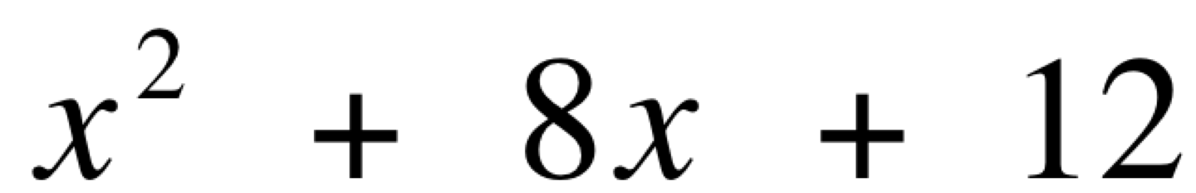
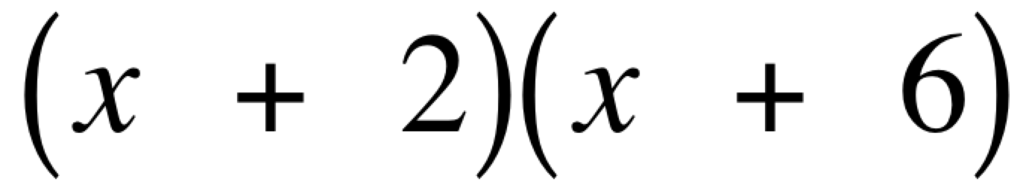
Factoring when a=1 and c > 0.
First list all the factor pairs of c.
1 , 12
2 , 6
3 , 4
Then find the factors with a sum of b
These numbers are used to make the factored expression.

Slide 4
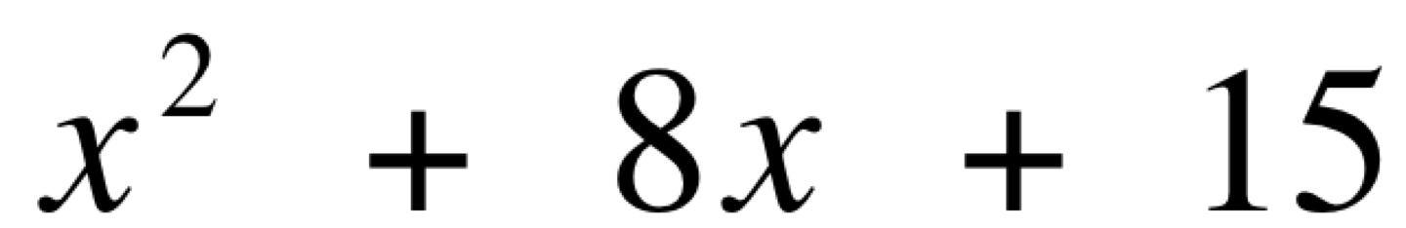
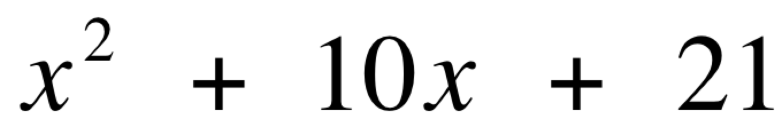

Now you try.
Factors of c:
Factors of c:
Circle the factors of c with the sum of b
Circle the factors of c with the sum of b
Binomial Factors
( ) ( )
Binomial Factors
( ) ( )

Slide 5
Factoring when c >0 and b < 0.
c is positive and b is negative.
Since a negative number times a negative number produces a positive answer, we can use the same method as before but…
The binomial factors will have subtraction instead of addition.

Slide 6
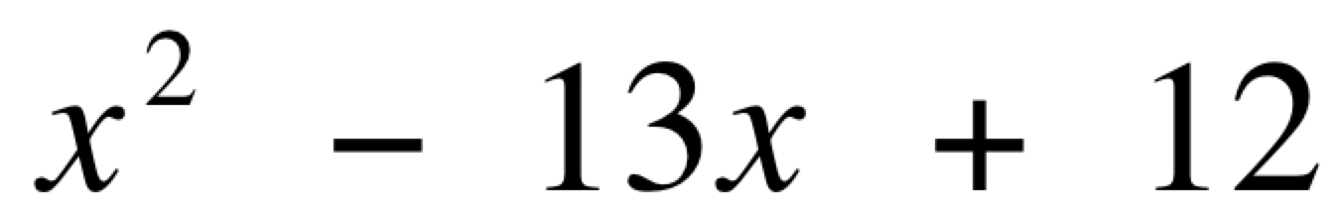
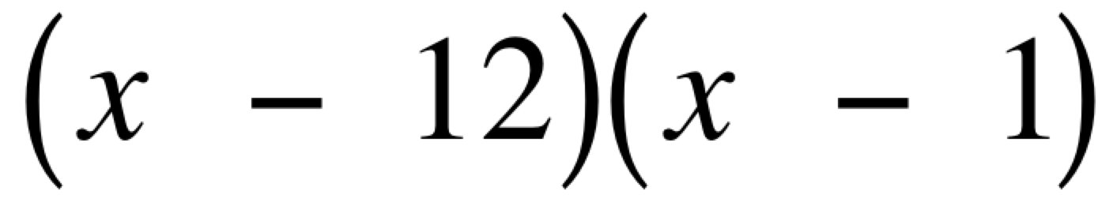
Let’s look at
First list the factors of 12
1 12
2 6
3 4
We need a sum of -13
Make sure both values are negative!

Slide 7
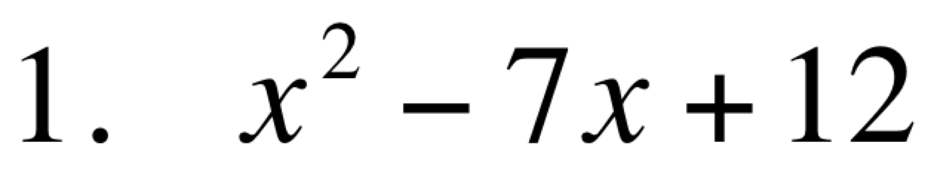
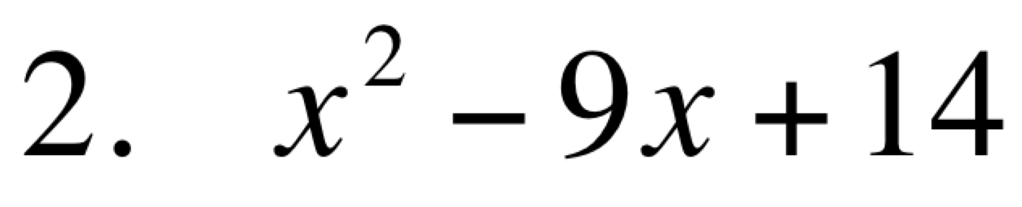
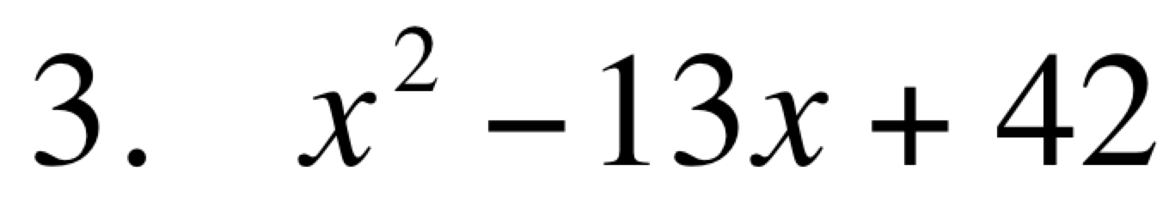
Now you try.

Slide 8
Factoring when c < 0.
We still look for the factors of c.
However, in this case, one factor should be positive and the other negative in order to get a negative value for c
Remember that the only way we can multiply two numbers and come up with a negative answer, is if one is number is positive and the other is negative!

Slide 9
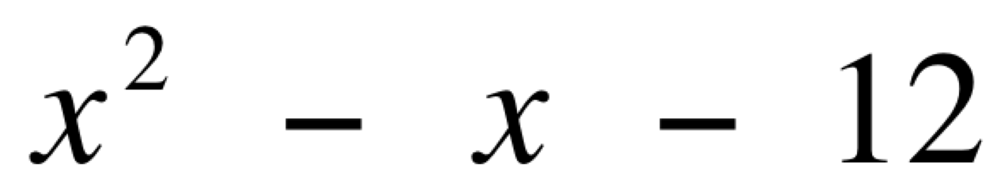
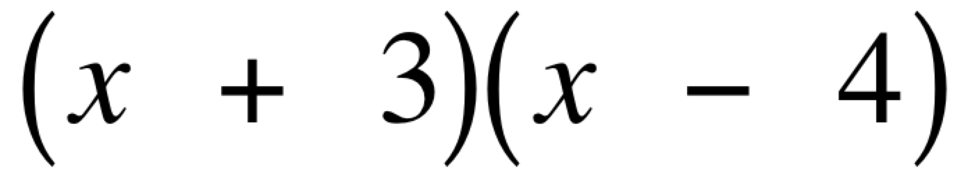
Let’s look at
In this case, one factor should be positive and the other negative.
1 12
2 6
3 4
We need a sum of -1
+
-

Slide 10
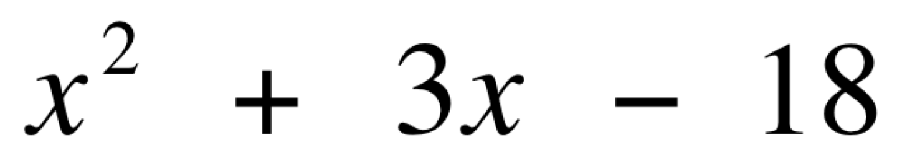
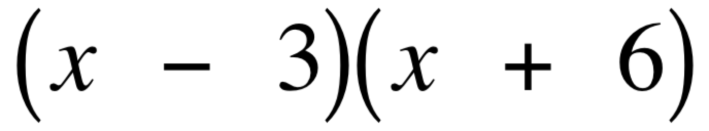
Another Example
List the factors of 18.
1 18
2 9
3 6
We need a sum of 3
What factors and signs
will we use?

Slide 11
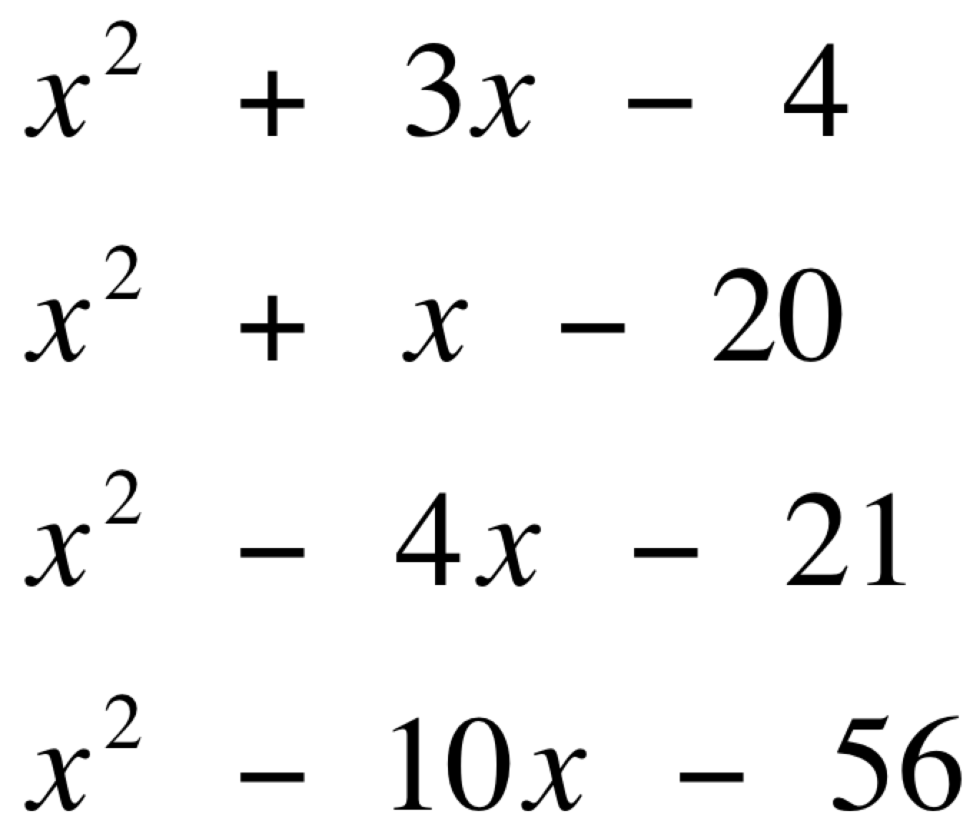
Now you try.
1.
2.
3.
4.

Slide 12
Prime Trinomials
Sometimes you will find a quadratic trinomial that is not factorable.
You will know this when you cannot get b from the list of factors.
When you encounter this write not factorable or prime.

Slide 13
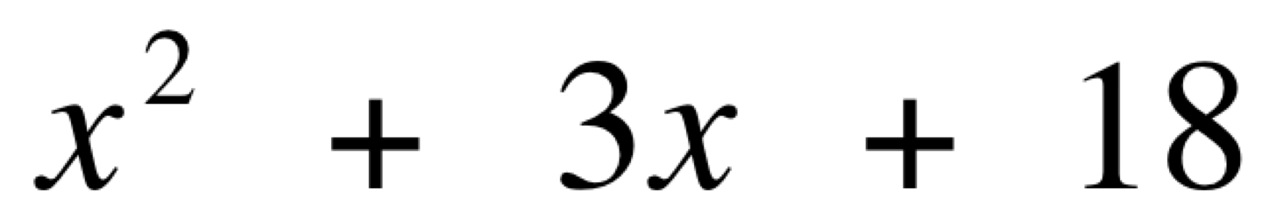
Here is an example…
1 18
2 9
3 6
Since none of the pairs adds to 3, this trinomial is prime.

Slide 14
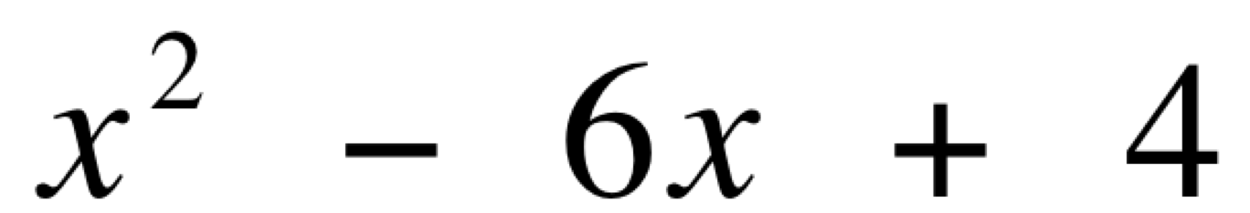
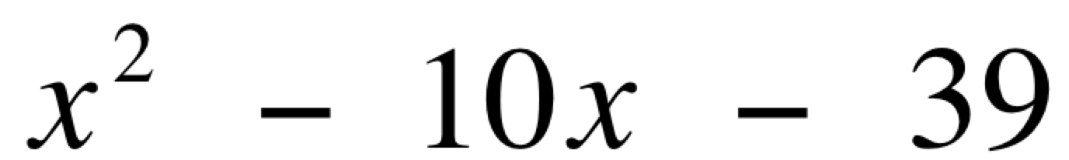
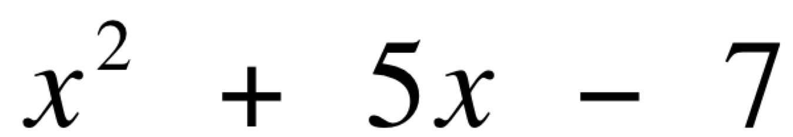
Now you try.
factorable
prime
factorable
prime
factorable
prime

Slide 15
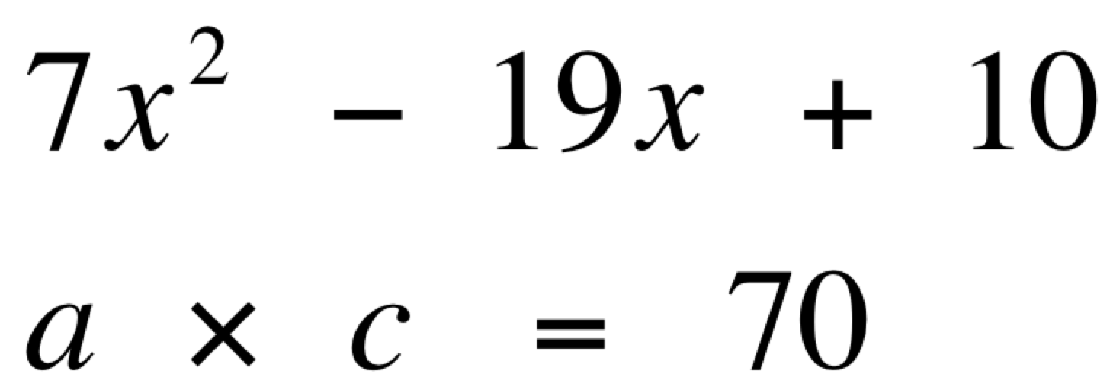
When a ≠ 1.
Instead of finding the factors of c:
Multiply a times c.
Then find the factors of this product.
1 70
2 35
5 14
7 10

Slide 16
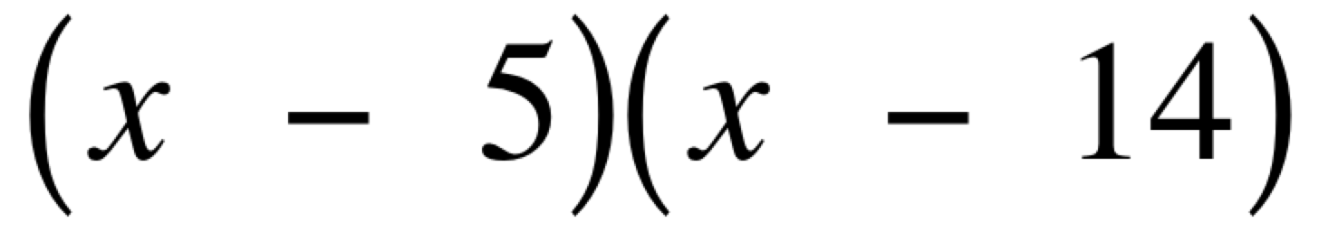
We still determine the factors that add to b.
1 70
2 35
5 14
7 10
So now we have
But we’re not finished yet….

Slide 17
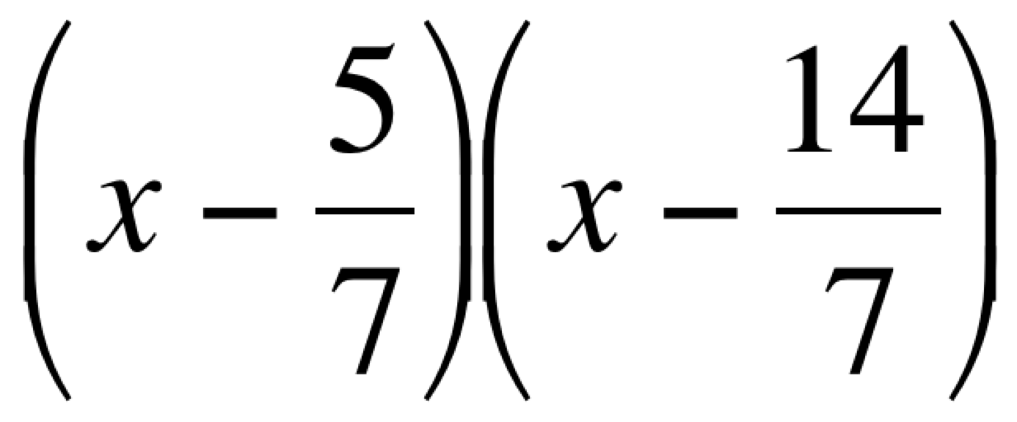
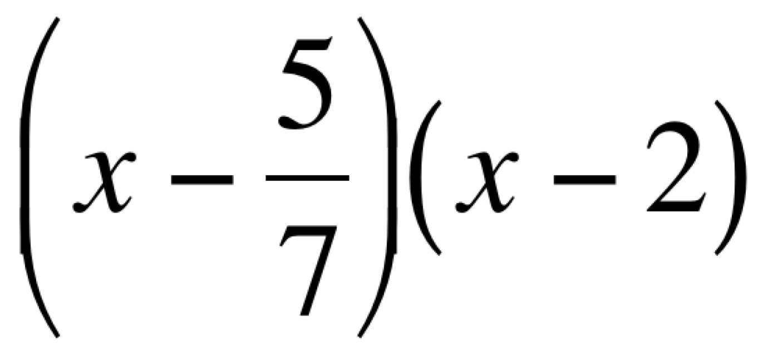
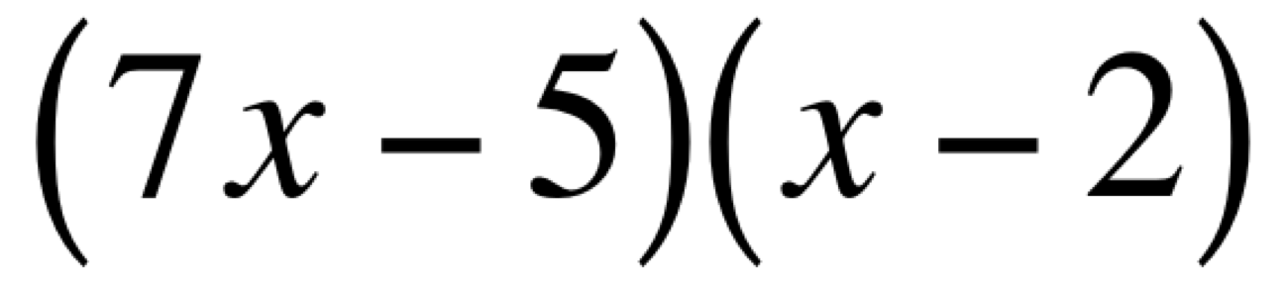
Since we multiplied in the beginning, we need to divide in the end.
Divide each constant by a.
Simplify, if possible.
Clear the fraction in each binomial factor

Slide 18
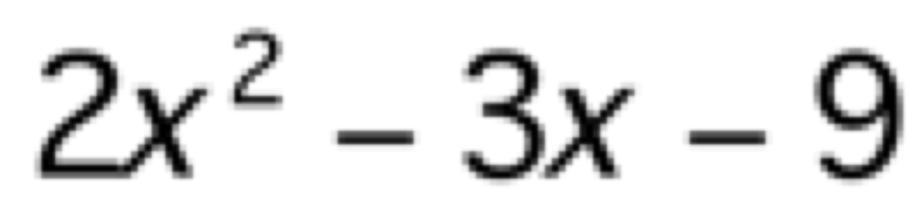
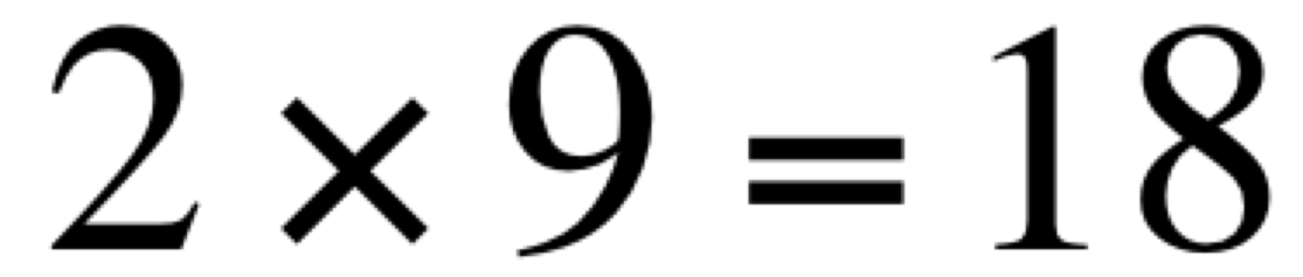
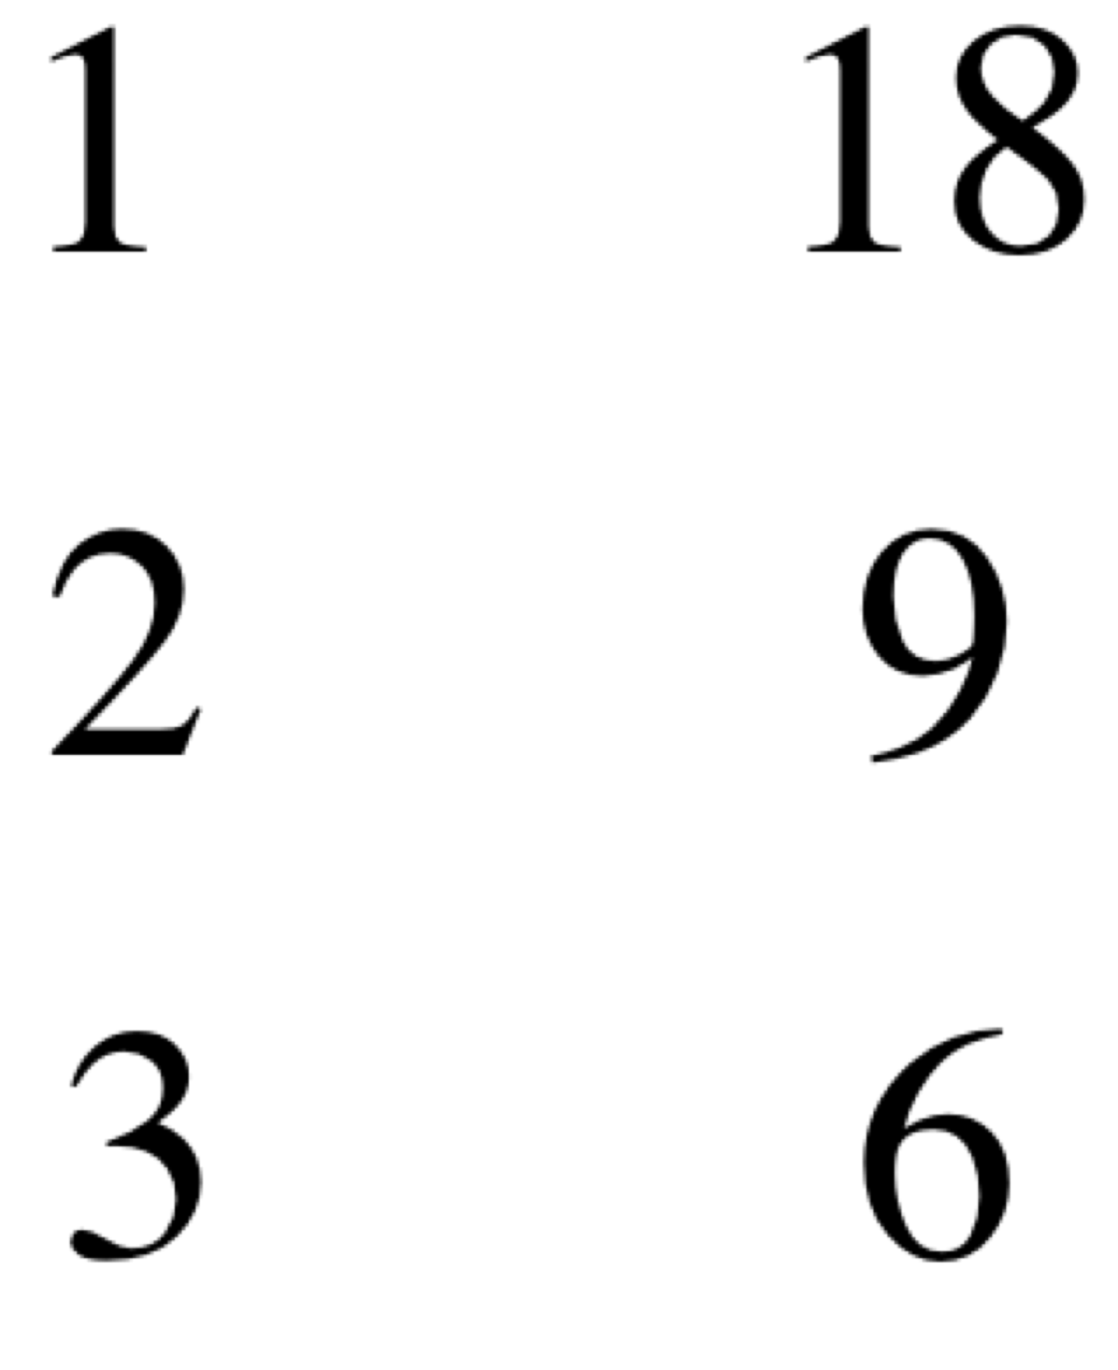
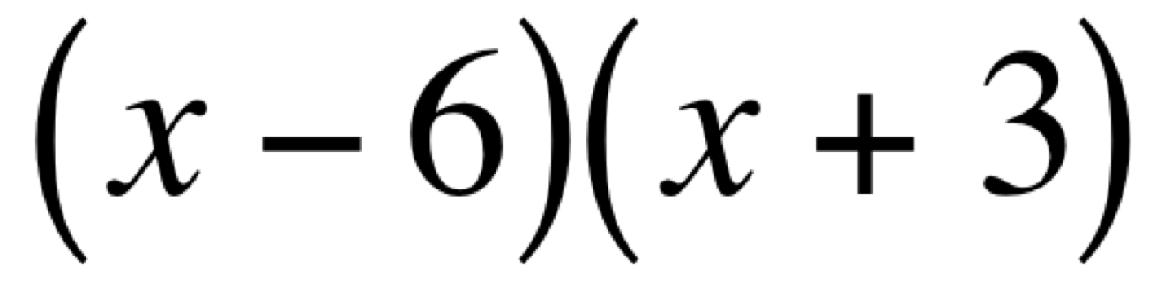
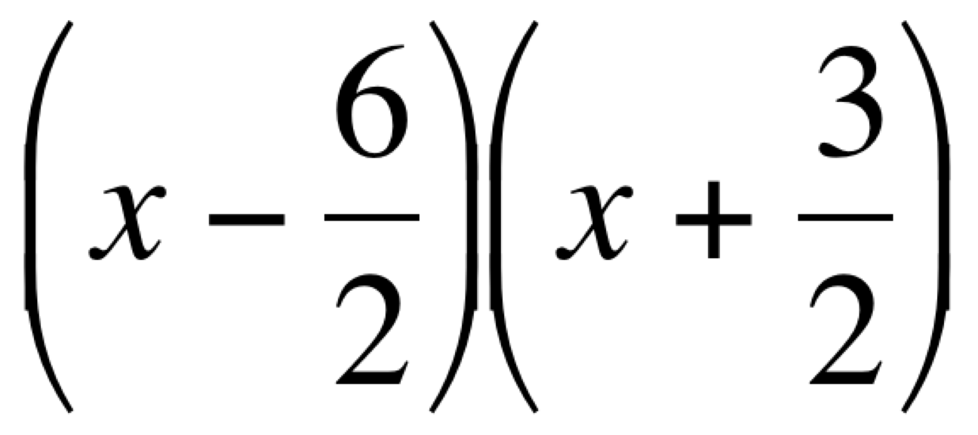
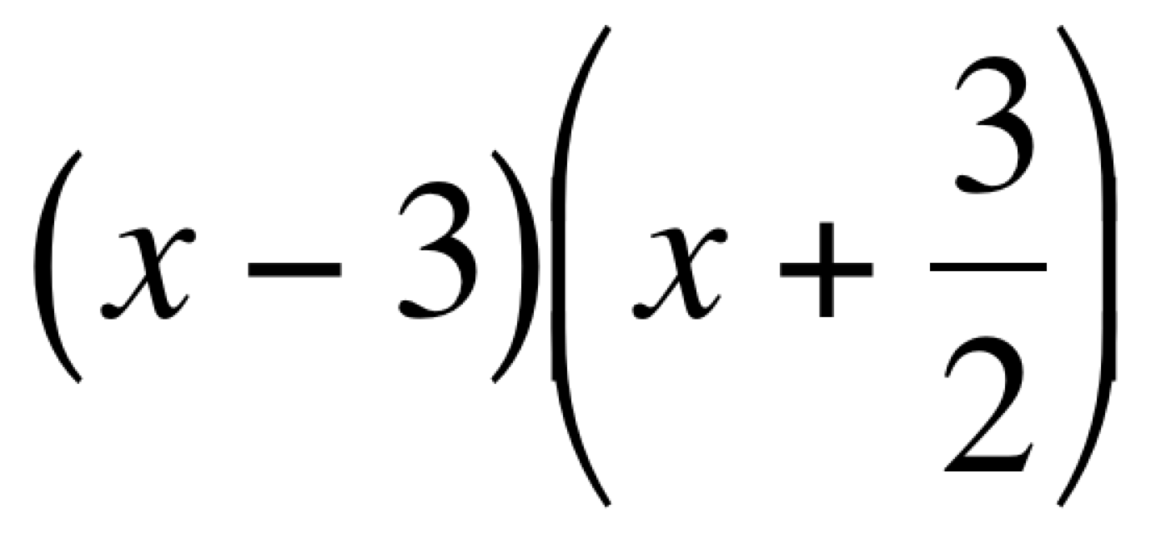
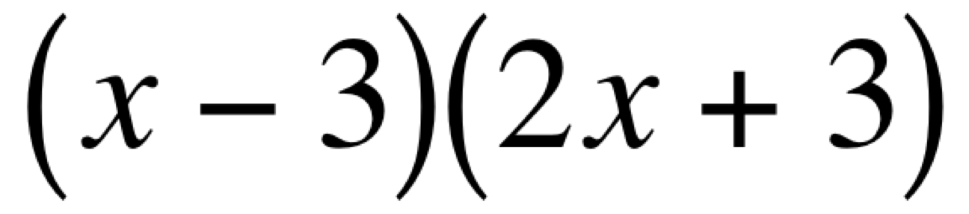
Recall
Multiply a times c.
List factors. Look for sum of b
Write 2 binomials using the factors with sum of b
Divide each constant by a.
Simplify, if possible.
Clear the fractions.

Slide 19
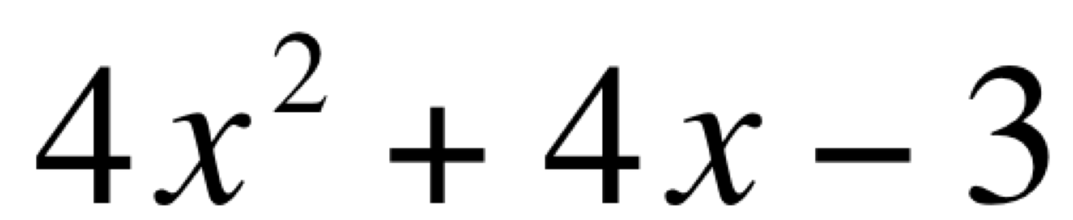
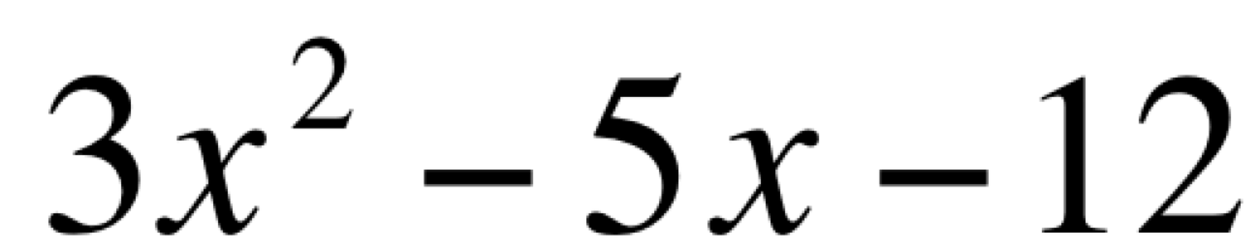
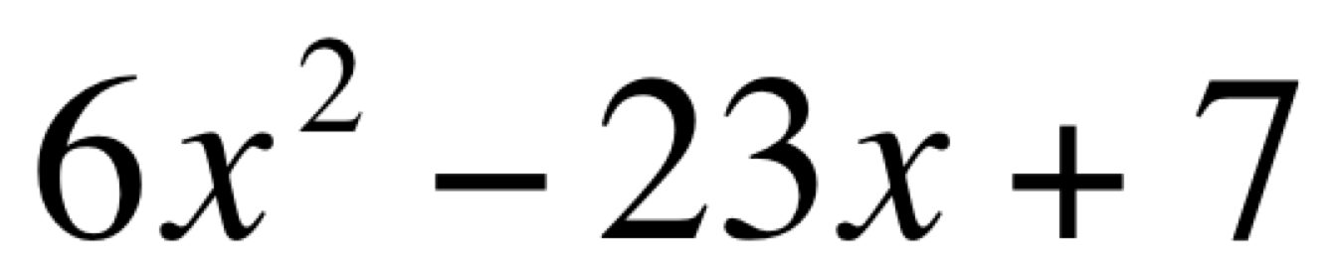
Now you try.

Slide 20
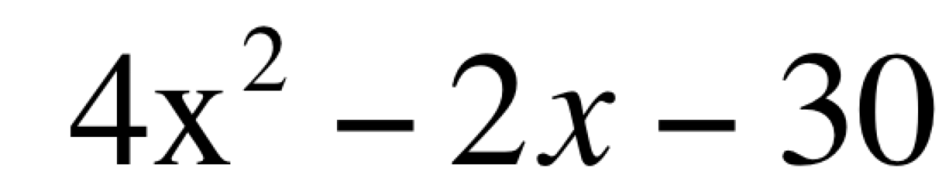
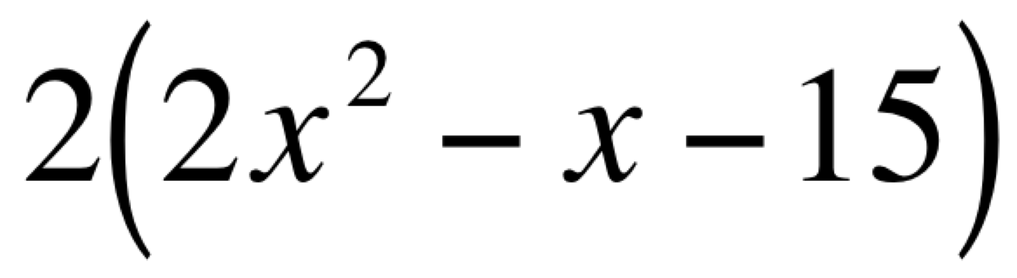
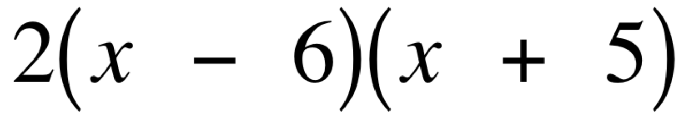
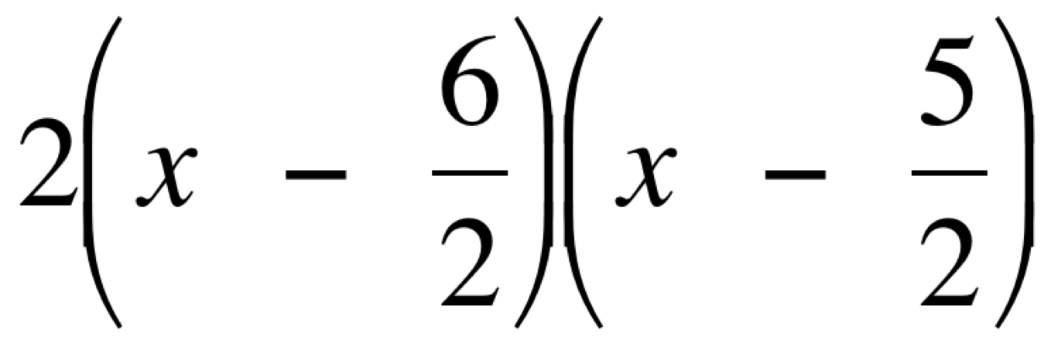
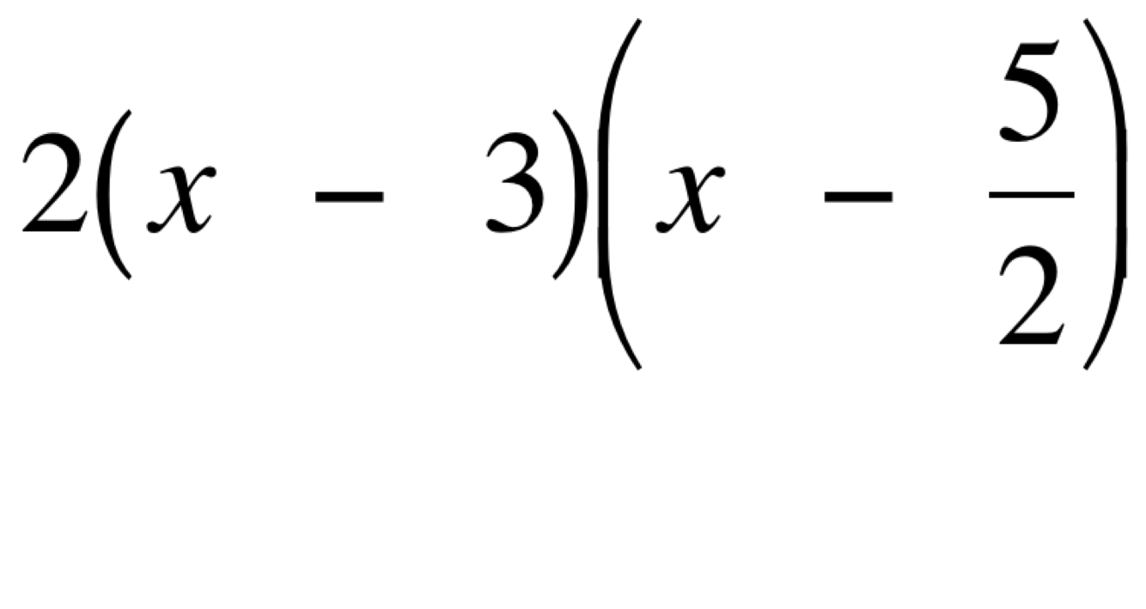
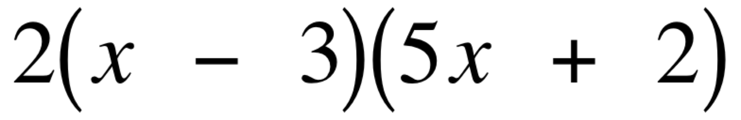
Sometimes there is a GCF.
If so, factor it out first.
Then use the previous methods to factor the trinomial

Slide 21
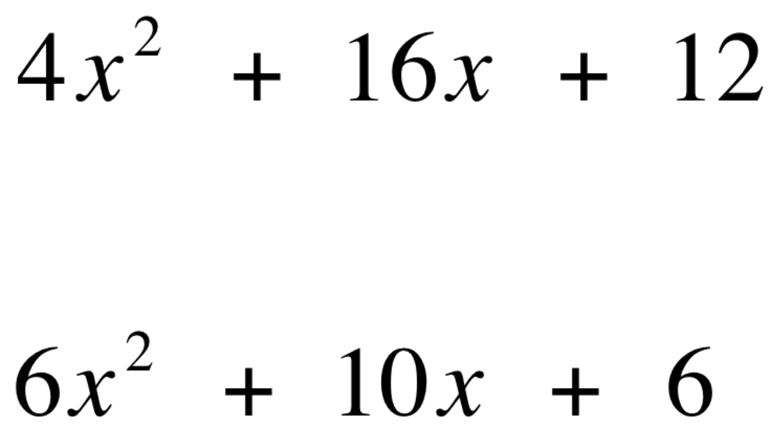
Now you try.
1.
2.

Slide 22
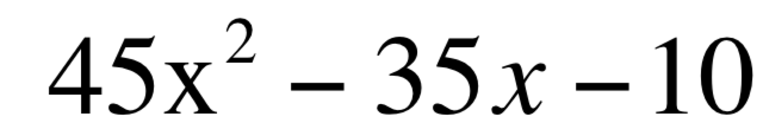
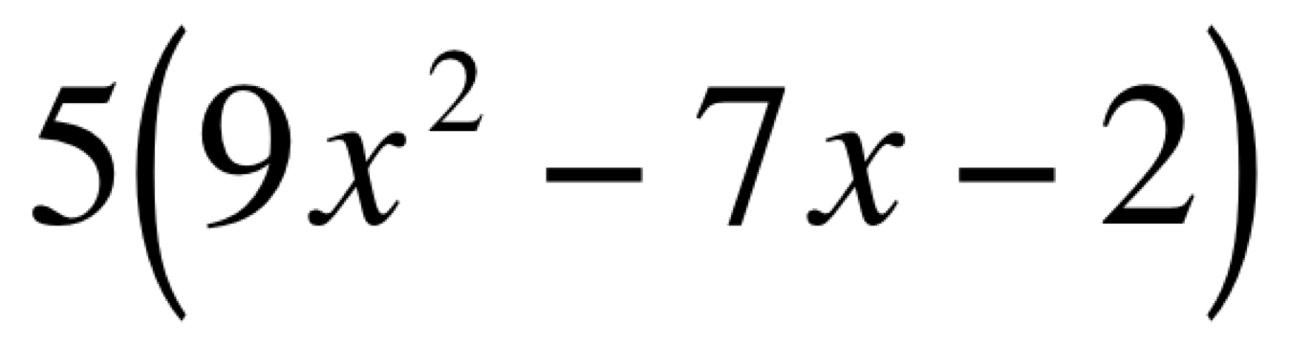
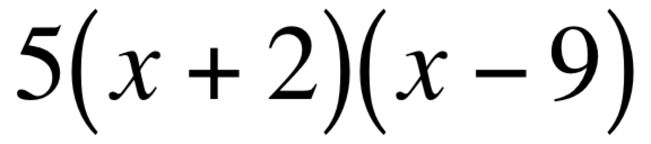
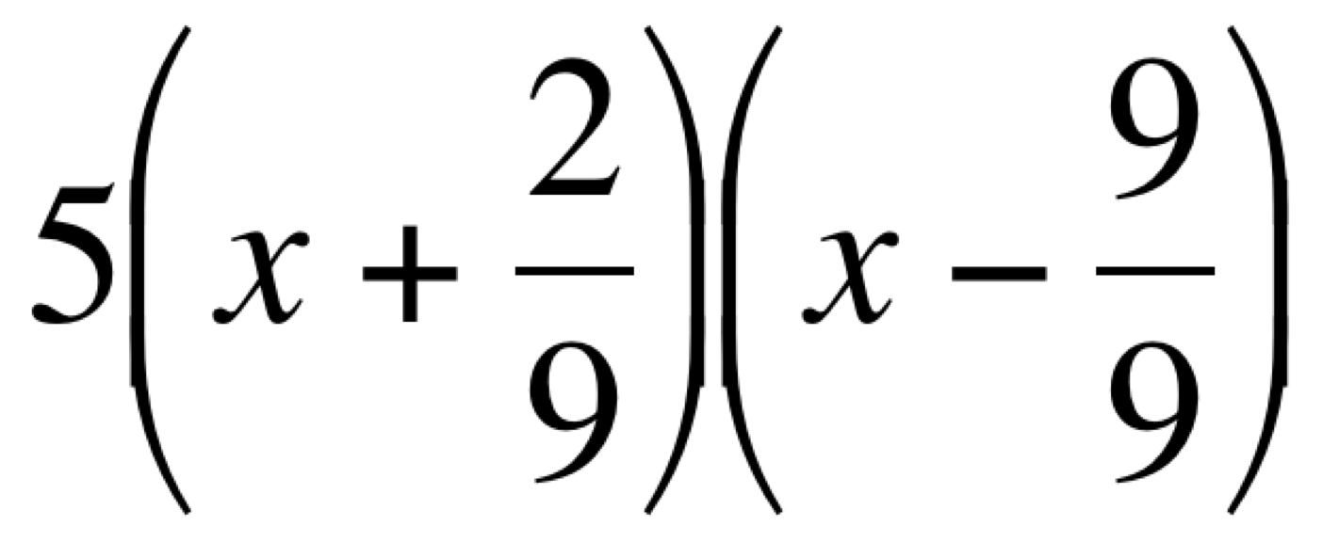
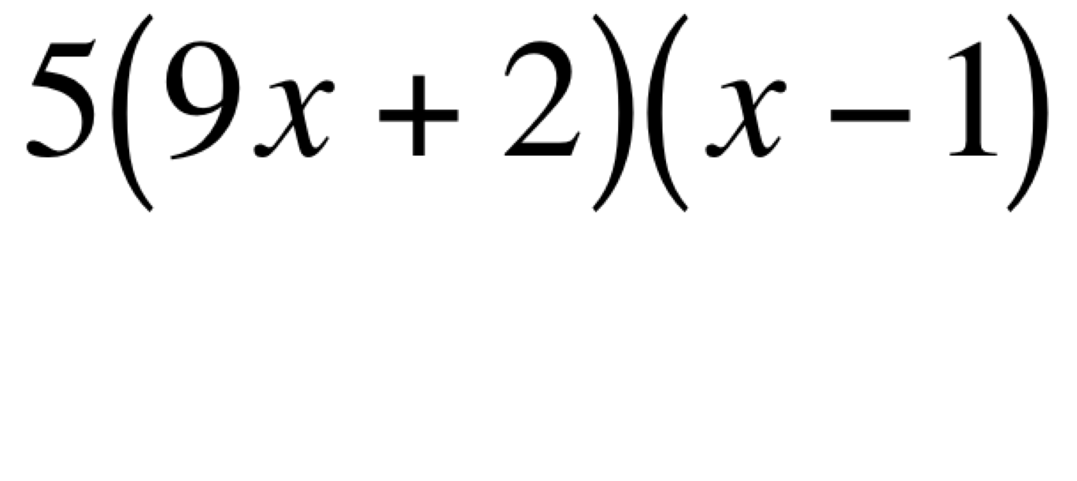

Recall
First factor out the GCF.
Then factor the remaining trinomial.

Slide 23


1.
2.

